Slide 1
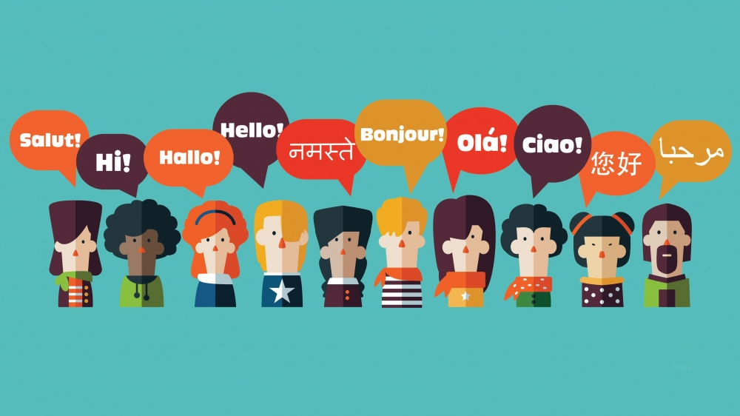
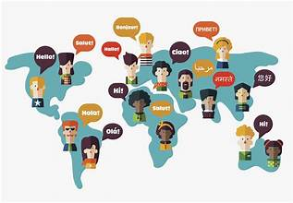
How different native languages shape writing and rhetoric
The Remediation
Ian Szwako
Professor Hensley
ENC 1102
12 June 2025

Slide 2
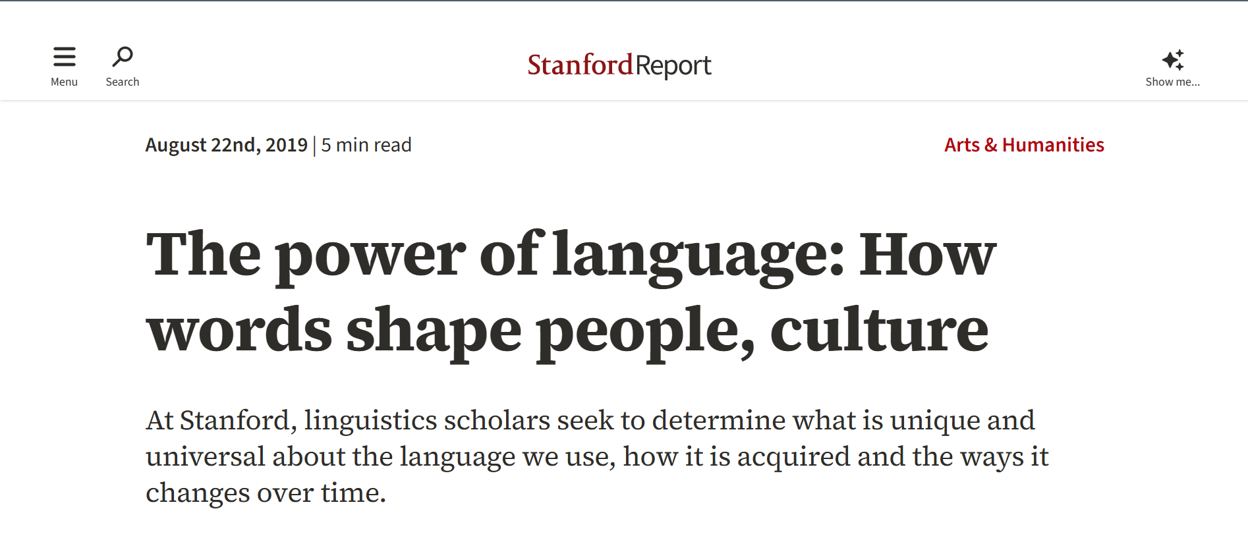
Article Overview
The article titled 'The Power of Language: How Words Shape People, Culture' was written by Clifton B. Parker and published by Stanford News. It introduces readers to the research of cognitive scientist Dr. Lera Boroditsky.
The main focus of the article is on linguistic relativity—the theory that language not only reflects our thoughts but actively shapes the way we think, perceive, and interact with the world.
Boroditsky's research offers compelling evidence from various cultures to show how language structures influence cognition. One example is the Kuuk Thaayorre people of Australia, who use cardinal directions instead of left/right, which strengthens their navigational skills.
Another example explores how grammatical gender affects perception: speakers of German and Spanish describe the word 'bridge' differently based on its gender in their respective languages.
The article aims to make complex academic research accessible to a general audience, using everyday language and relatable examples to illustrate key ideas in cognitive science and linguistics.

Slide 3
Article’s Strengths and Weaknesses
Strengths
Weaknesses
Clear structure, simple language
Real-life examples make abstract ideas relatable
Makes academic research accessible to general readers
Lacks critical analysis and opposing viewpoints
Fails to explore practical applications deeply (e.g., education, AI)
Not suitable as a scholarly source due to lack of peer-reviewed support

